Slide 1
JavaScript Events
And how to make your web pages not suck

Slide 2
What the Heck are You Talking About?
JavaScript Events Man!
What they are
How to use them
Common events
Examples! So many examples

Slide 3
What is a JavaScript Event Brosef?
When you do something, something else happens!
With a little JavaScript thrown in.
First we need to talk about HTML events and then JavaScript events

Slide 4
I Thought we were talking about JavaScript
We are! But we gotta talk about HTML first.
An HTML event is when something happens either by the user or the web page itself.
Examples:
onClick
onFocus
onChange
onMouseOver
onload
^ that garbage

Slide 5
That’s all well and good but what about JavaScript!?
Dude, seriously I’m getting to it.
HTML events are things that happen to HTML elements, JavaScript events are the reactions to those changes.
Basically, HTML events are the triggers to run JavaScript code. That is a JavaScript Event
Example
<onClick = “doFunction()”>
OnClick is the HTML Event and the “doFunction” is the reaction to the HTML event.

Slide 6
That’s it?
Yeah pretty much.

Slide 7
There’s gotta be more…
There are different ways to initiate a JavaScript Event.
Event Handler Properties
Inline Event Handlers
addEventListener() and removeEventListener()

Slide 8
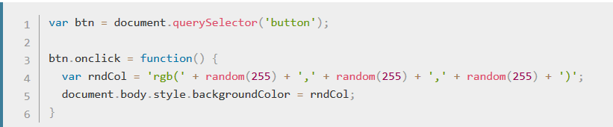
Event Handler Properties? What is that
Basically you put the event (OnClick, OnLoad) as part of your javaScript like so:
Here we can see the ‘btn’ variable which is assigned to the HTML document, Then the btn.onclick function.
This is good practice so it keeps your HTML and JavaScript separate from each other.

Slide 9
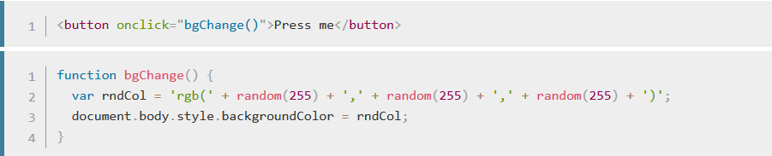
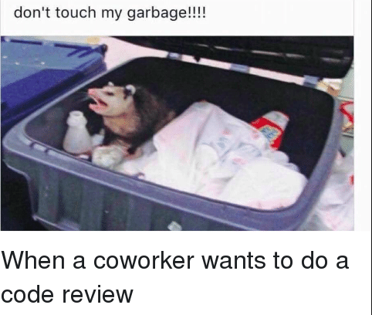
What the What? Inline Event Handlers
When you call a function in your HTML like so:
This is considered bad practice as it mixes your HTML and JavaScript and can become unmanageable.
Avoid this

Slide 10
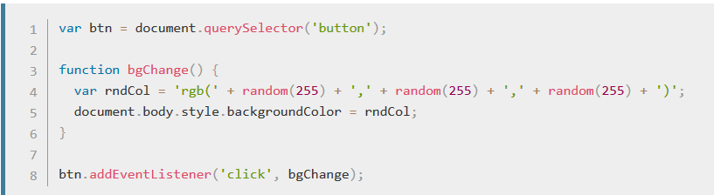
AddEventLisener() and RemoveEventListener(): Cool Kids on the Block
This is the newest mechanism for event handling and is similar to event handler properties.
The benefit here is that the button variable is further removed from the function itself and can allow the bgChange function to be used by other events.

Slide 11

Cool! So when should I use these?
As I mentioned, don’t use inline event handlers because that leads to messy code and everyone will hate you.
Other than that, Event Properties and addEventListner() are pretty much interchangeable.
One benefit to addEventListener() is that you can have one HTML event kick off multiple JS Events:

Slide 12
Thanks Zach! My Code is Going to be AWESOME!
Yeah I know.
If you wanna learn more about how to make your code awesome with events, check this out
https://developer.mozilla.org/en-US/docs/Learn/JavaScript/Building_blocks/Events

